Slide 1





Mapping Cultural Activities Linked to Nature to Demonstrate the Global Impact of Changes in Climate and Phenology
Ashley Schmeltzer
Jake Weltzin, USA NPN (Mentor)
Alyssa Rosemartin, USA NPN
USA National Phenology Network
NASA Space Grant Undergraduate Research Internship Program
University of Arizona
2009-2010

Slide 2
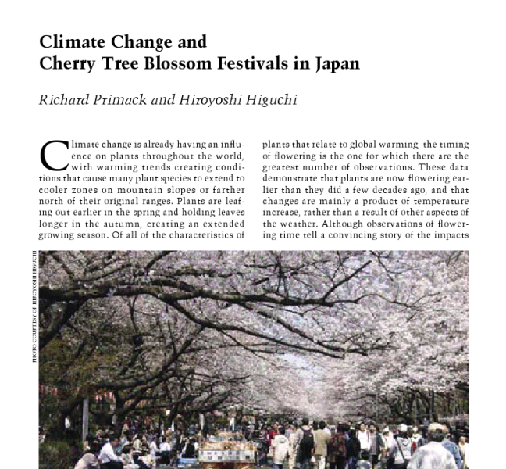

Inspiration and Purpose
Nature
Society
Phenology (timing of plant and animal life cycle events)
Climate Change

Slide 3
Process
Locate nature-based festivals and events
Create working database
Determine appropriate mapping structure
Add data into map
Clean and modify map to be user-friendly and aesthetically pleasing

Slide 4
The Data
Names of the festival
Location
Continent, Country, Province, State, City
Websites (If available)
Main, Supporting
Type and Species/Focus
Temporal
Month, Dates (2010), Timing on phenology, Year started
Articles
Phenological change or climate change analysis

Slide 5
Methods/Analysis Techniques
Extensive Online Research
Literature Search
Word of Mouth
Databases
Drupal
GMAP

Slide 6
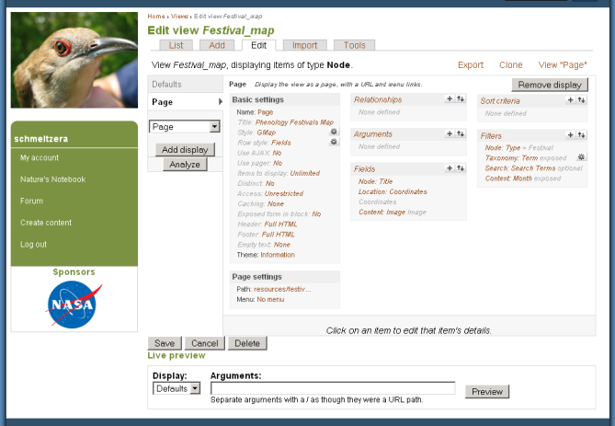
Methods/Analysis Techniques

Slide 7
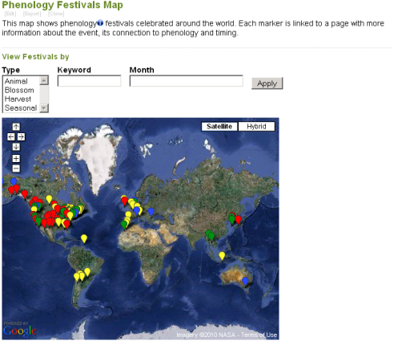
Results: A Searchable Database and Coupled Interactive Map
Animal
Harvest
Seasonal
Blossom

Slide 8
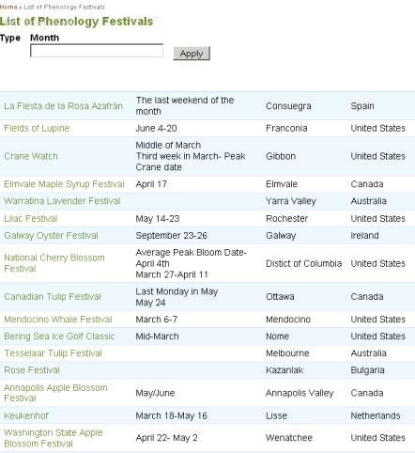
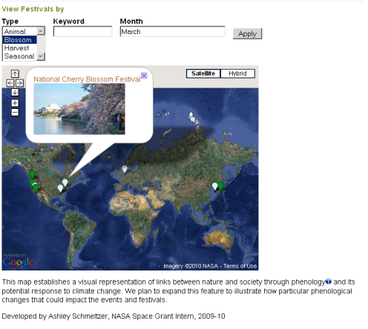
Results: Lists and Query

Slide 9
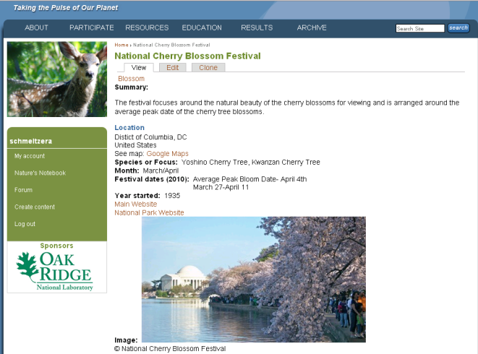
Results: Detailed Information Pages

Slide 10
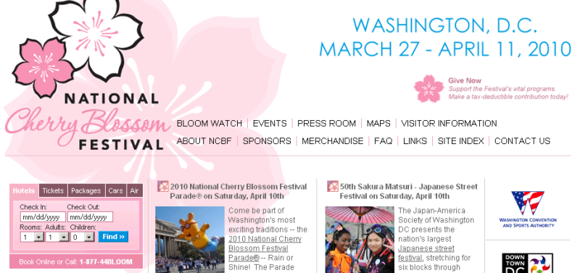
Results: Direct Links to World-Wide Applications

Slide 11
Significance
Education and Outreach
Research and Development
Insight into the Connections between Nature and Society
Potential Challenges

Slide 12
Acknowledgements
Jake Weltzin, USA NPN Executive Director
Alyssa Rosemartin, USA NPN IT Project Manager
Abraham Miller-Rushing, USA NPA Assistant Director and Project Manager
USA National Phenology Network
USGS
Susan Brew
UA NASA Space Grant Staff

Slide 13
Thank You

